Slide 1
Aggregation and Granularity
CSC105
Prof. Earl

Slide 2
Aggregation

Slide 3
Aggregation
Webster’s Dictionary: “a group, body, or mass composed of many distinct parts or individuals”
Tableau Glossary: “A result of a mathematical operation applied to a measure. Predefined aggregations include summation and average. You can convert dimensions to measures by aggregating them as a count. For relational data sources, all measures must be either aggregated or disaggregated (unless they appear on the Filters shelf). Tableau aggregates measures, usually as a summation, when you place them on a shelf.”

Slide 4
Aggregation
Refers to how data are combined, such as summing all Google searches for Pumpkin Spice lattes for 2019 or taking the average of all the temperature readings around Seattle on a given day.
By default, measures in Tableau are always aggregated. The default aggregation is SUM. You can change the aggregation to things like Average, Median, Count Distinct, Minimum, etc.

Slide 5
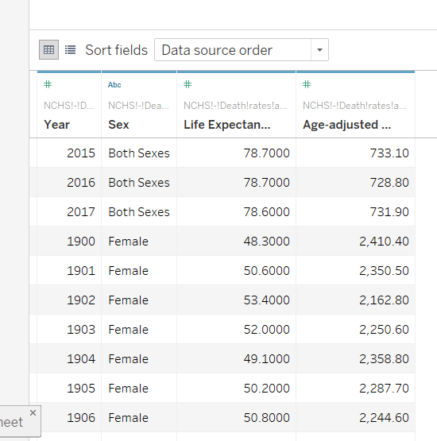
Practice with Aggregations: Life Expectancy Data
Connect to data in Tableau
View the data on the Data Source tab

Slide 6
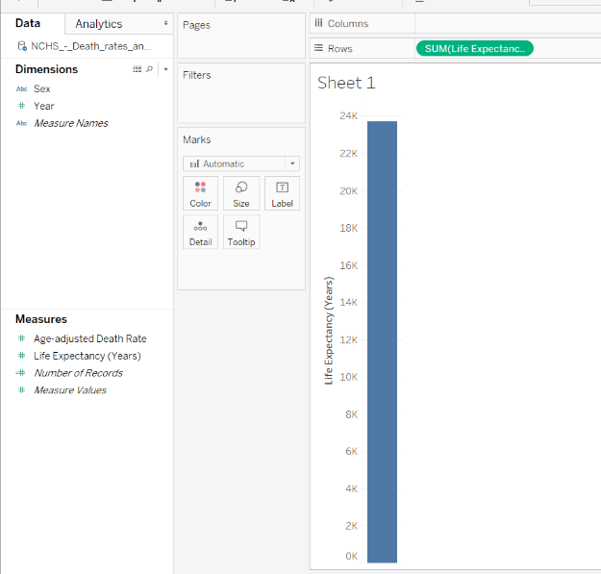
Practice with Aggregations
Drag Life Expectancy onto rows shelf
What is going on?

Slide 7
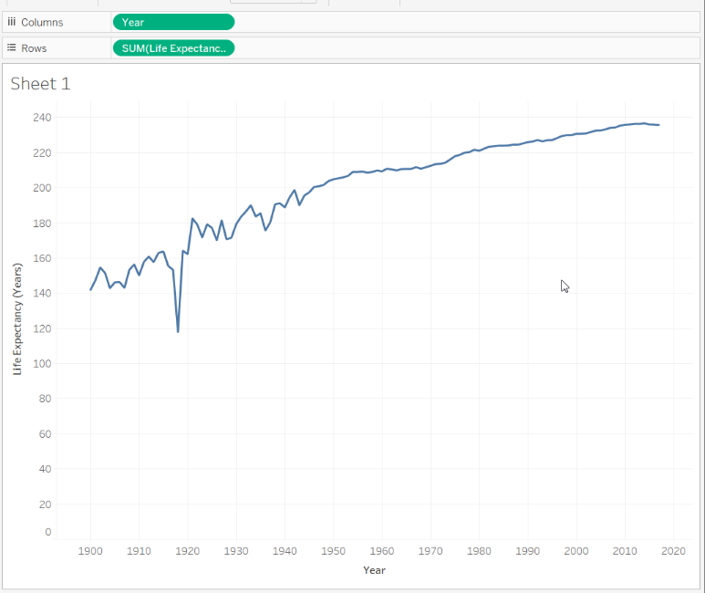
Practice with Aggregations-Life Expectancy Data
Place Year on Columns shelf

Slide 8
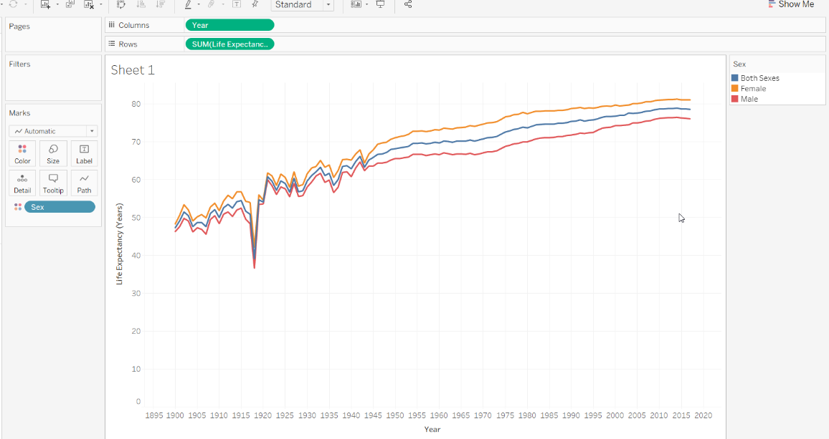
Practice with Aggregations-Life Expectancy Data
Drag Sex onto color

Slide 9
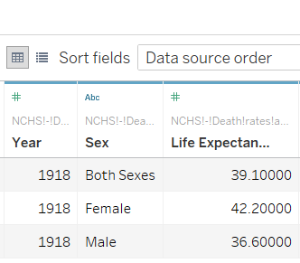
Let’s focus on 1918
Sum Aggregation
117.9

Slide 10
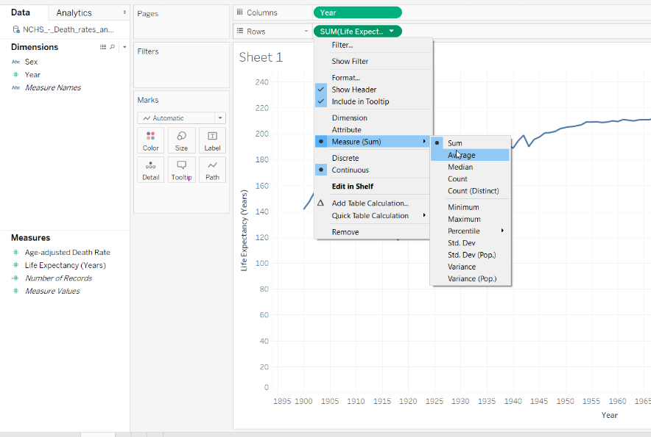
Let’s focus on 1918

Slide 11
Let’s focus on 1918
AVG Aggregation
39.3

Slide 12
Let’s focus on 1918
MEDIAN Aggregation
39.1

Slide 13
Let’s focus on 1918
CNT Aggregation
3

Slide 14
Let’s focus on 1918
MIN Aggregation
36.6

Slide 15
Let’s focus on 1918
MAX Aggregation
42.2

Slide 16
Practice with Aggregations-Life Expectancy Data
Drag Sex onto color

Slide 17
Granularity

Slide 18
Granularity
Refers to how detailed the data is. What does a row (aka record) in the data set represent? A person with malaria? A provinces' total cases of malaria for the month? That's the granularity.
Knowing the granularity of the data is crucial to working with LOD (level of detail) expressions.

Slide 19
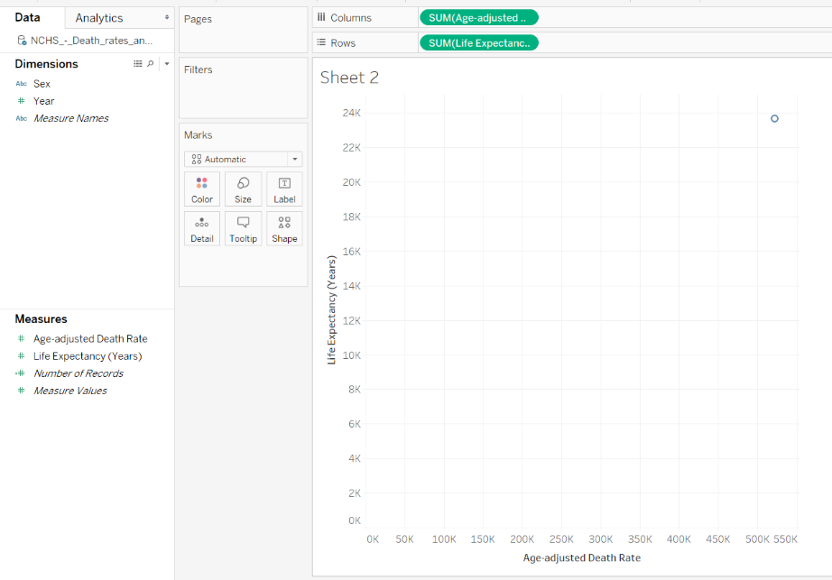
Scatterplot Example
Open New Worksheet
Drag Age-adjusted Death Rate to columns shelf
Drag Life Expectancy to Rows

Slide 20
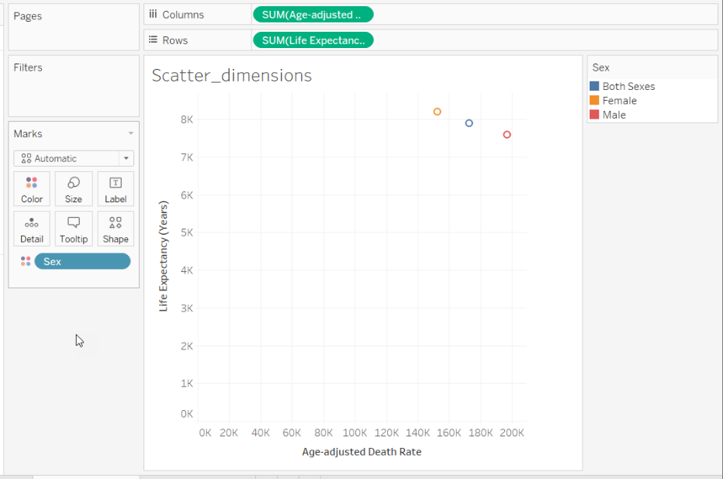
Scatterplot Example
Open New Worksheet
Drag Age-adjusted Death Rate to columns shelf
Drag Life Expectancy to Rows
Drag Sex onto Color

Slide 21
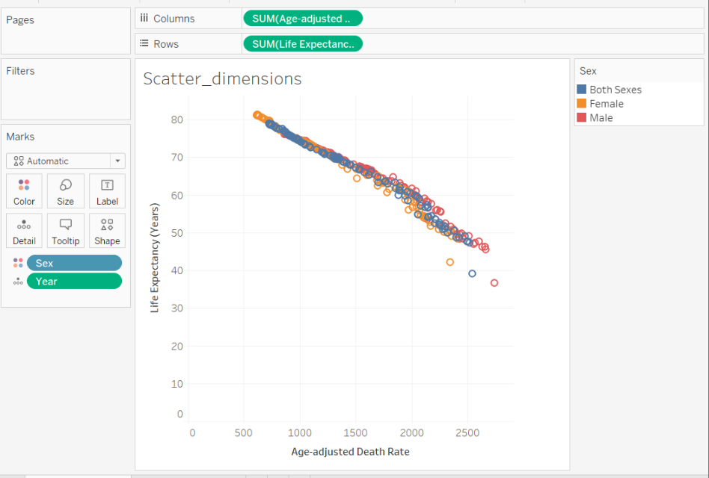
Scatterplot Example
Open New Worksheet
Drag Age-adjusted Death Rate to columns shelf
Drag Life Expectancy to Rows
Drag Sex onto Color
Drag Year onto Detail

Slide 22
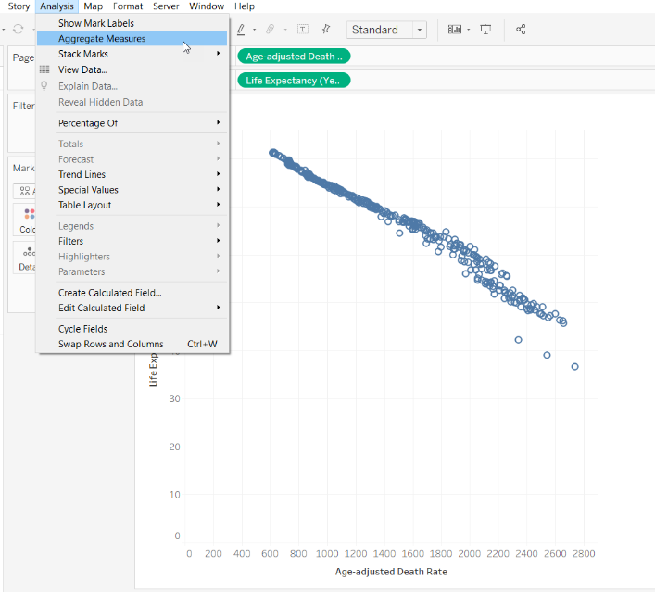
Scatterplot Example-Disaggregate
Undo two steps to the view with one mark
Click Analysis menu and uncheck Aggregate Measures

